Slide 1

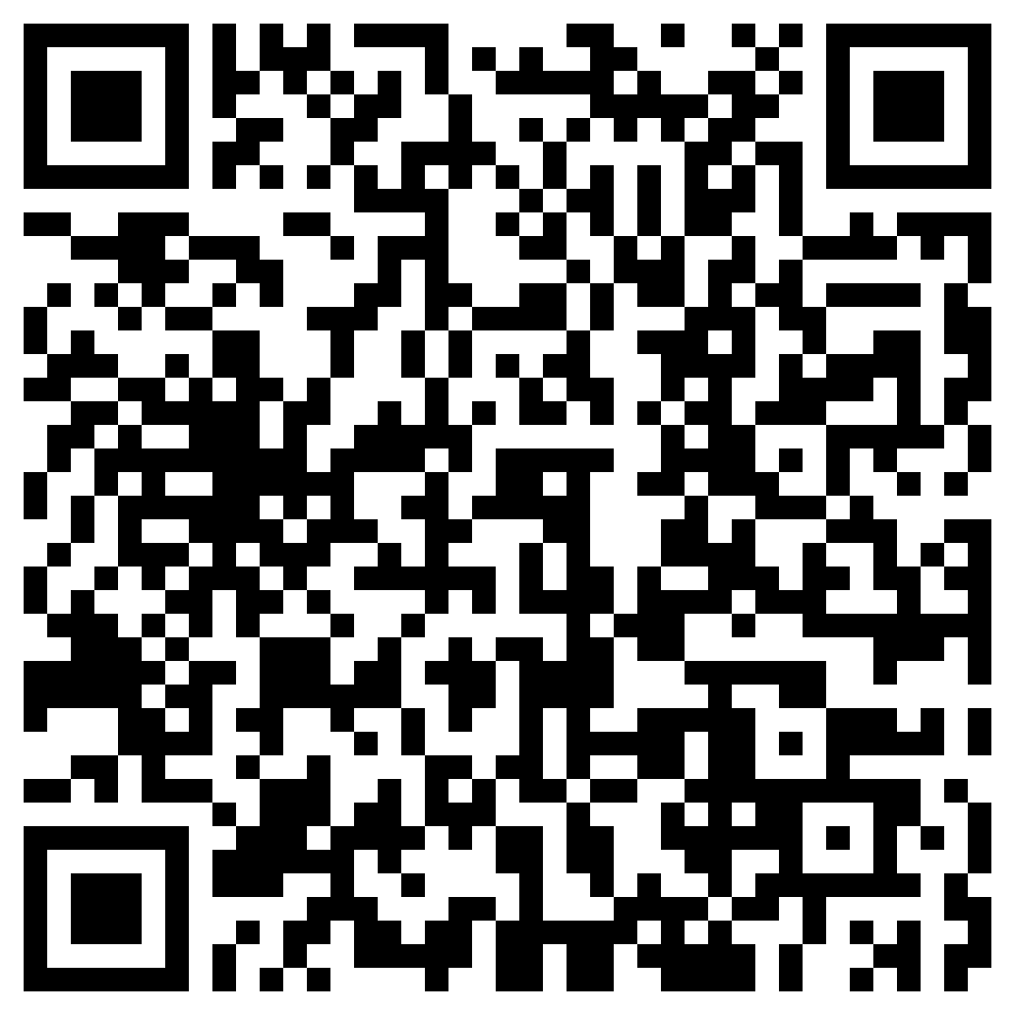


SemiFL: Semi-Supervised Federated Learning for Unlabeled Clients with Alternate Training
Presenter: Enmao Diao
Paper
Code
Enmao Diao¹ Jie Ding² Vahid Tarokh¹
¹Duke University ²University of Minnesota
Notes:
Hello everyone my name is Enmao Diao today I will present SemiFL: Semi-Supervised Federated Learning for Unlabeled Clients with Alternate Training.
This work is published by Enmao Diao, Jie Ding, and Vahid Tarokh .
You can access our paper and source codes by scanning these QR codes.

Slide 2
Overview
Motivation
Semi-Supervised Federated Learning
Communication Efficient FL with SSL
Theoretical Analysis of Strong Data augmentation for SSL
Alternate Training
Experiments
Comparison with SSL methods
Comparison with FL and SSFL methods
Ablation studies
Conclusion
Notes:
First, I will talk about our motivation.
Then I will introduce our proposed method Semi-Supervised Federated Learning
Next, I will demonstrate our experimental results comparing with various baselines
Finally, I will draw our conclusion and discuss future works.

Slide 3
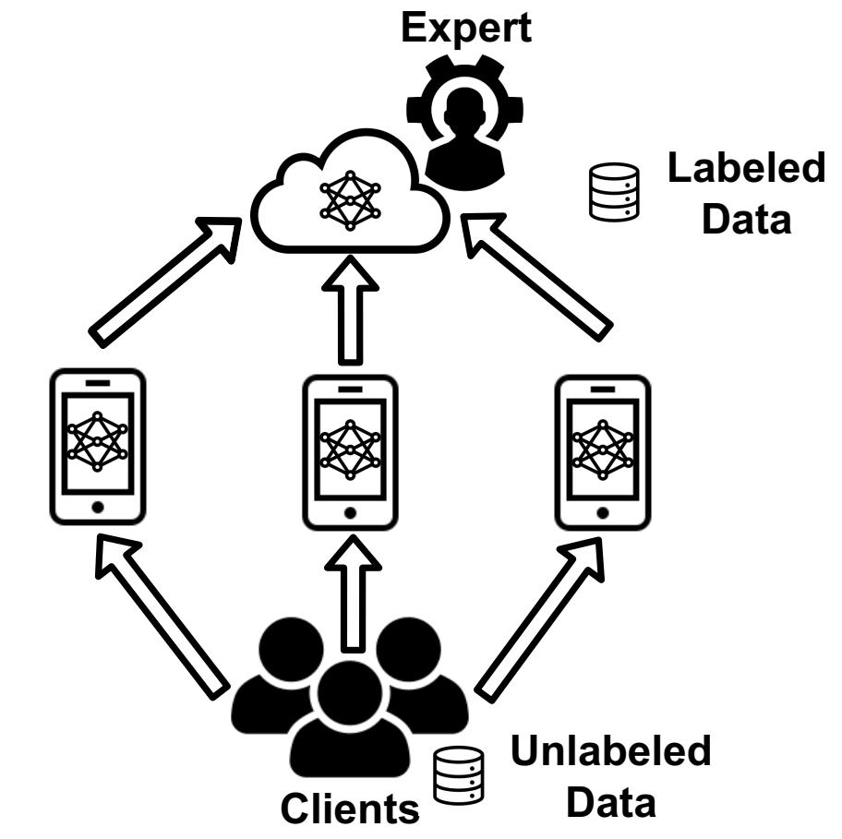
Motivation
Existing works of FL assume clients have ground-truth labels
Challenging to directly combine the state-of-the-art SSL methods with the communication efficient federated learning methods such as FedAvg
Figure 1. A resourceful server with labeled data can significantly improve its learning performance by working with distributed clients with unlabeled data without data sharing.
Notes:
Most existing works of FL focus on supervised learning tasks assuming that clients have ground-truth labels. However, in many practical scenarios, most clients may not be experts in the task of interest to label their data. In particular, the private data of each client may be completely unlabeled.
For instance, a healthcare system may involve a central hub (``server'') with domain experts and a limited amount of labeled data (such as medical records), together with many rural branches with non-experts and a massive amount of unlabeled data. The above scenarios naturally lead to the following important question: \textit{How a server that hosts a labeled dataset can leverage clients with unlabeled data for a supervised learning task in the Federated Learning setting?}
We discover that it is challenging to directly combine the state-of-the-art SSL methods with the communication efficient federated learning methods such as FedAvg to allow local clients to train multiple epochs.

Slide 4
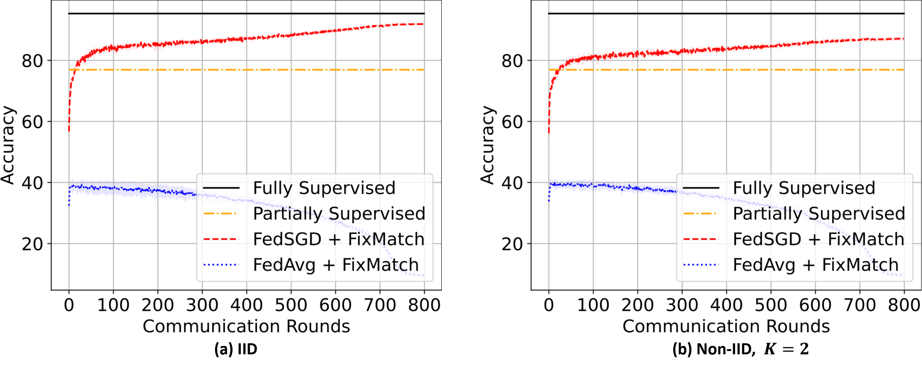

Semi-Supervised Federated Learning (SemiFL)
Communication Efficient FL with SSL
Supervised dataset $S$, unsupervised dataset $U$, and $N_{S}≪N_{U}$
SSL methods such as FixMatch can only work with FedSGD
Figure 2. Results of CIFAR10 dataset with (a) IID and (b) Non-IID, $K=2$ data partition and $N_{S}=4000$with a vanilla combination of communication efficient FL with SSFL methods.
Notes:
In a Semi-Supervised Learning classification task, we have two datasets, namely a supervised dataset $\mathcal{S}$ and an unsupervised dataset $\mathcal{U}$. It is often interesting to study the case where the size of labeled dataset is much larger than the size of unlabeled dataset
As shown in Figure 2, SSL methods such as FixMatch can only work with FedSGD, which requires batch-wise gradient aggregation and thus is not communication efficient. Thus, it is not straightforward how we can combine the SSL method in a communication-efficient FL scenario where we train multiple local epochs.
This is because SSL methods, such as FixMatch and MixMatch, sample from both labeled and unlabeled datasets for every batch of training data with a carefully tuned ratio~\cite{sohn2020fixmatch, berthelot2019mixmatch}. Thus, it is not straightforward how we can combine the SSL method in a communication-efficient FL scenario where we train multiple local epochs. To understand the bottleneck of this vanilla combination, we need to understand better why the state-of-the-art centralized SSL methods work.

Slide 5
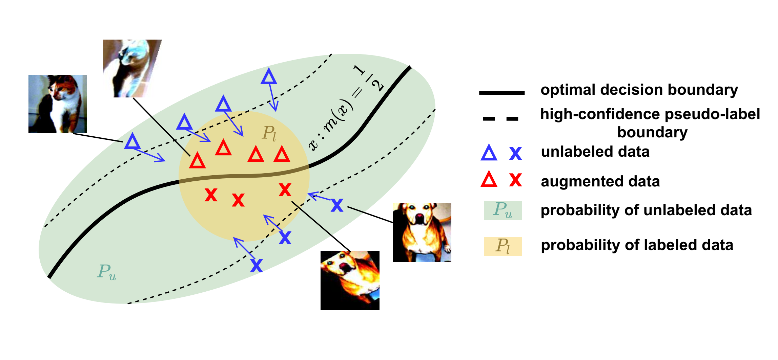
Semi-Supervised Federated Learning (SemiFL)
Theoretical Analysis of Strong Data augmentation for SSL
Reliable task-specific information exhibited from unlabeled data can be transmitted to data regimes that may have been insufficiently trained with labeled data
Figure 3. An illustration of the strong data augmentation-based SSL.
Notes:
To provide further insights into SSL, we develop a theoretical analysis of the strong data augmentation, which is a critical component of the state-of-the-art SSL method FixMatch \cite{sohn2020fixmatch} and can be interesting in its own right. We demonstrate that reliable information exhibited from unlabeled data can be ``transmitted'' to data regimes that may have been insufficiently trained with labeled data

Slide 6
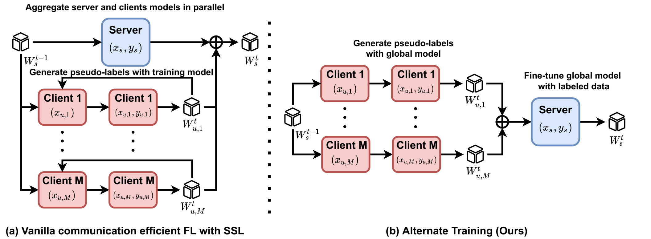
Semi-Supervised Federated Learning (SemiFL)
Alternate Training
Fine-tune global model with labeled data
Generate pseudo-labels with global model
The SemiFL algorithm
Figure 4. An illustration of (a) vanilla combination of communication efficient FL and SSL, and
(b) Alternate Training (Ours).
Notes:
In the communication efficient FL setting, we cannot guarantee an increase in the quality of pseudo-labels during training because we allow local clients to train multiple epochs, potentially deteriorating the performance.
To maintain and improve the quality of our generated pseudo-labels during training, we propose to train the labeled server and unlabeled clients in an alternate manner
To Fine-tune global model with labeled data at each round, the server will retrain the global model with the labeled data
When we Generate pseudo-labels with global model, We will label the unlabeled data once the active clients immediately receive the global model from the server.
The details of our proposed SemiFL algorithm are demonstrated in our paper.

Slide 7
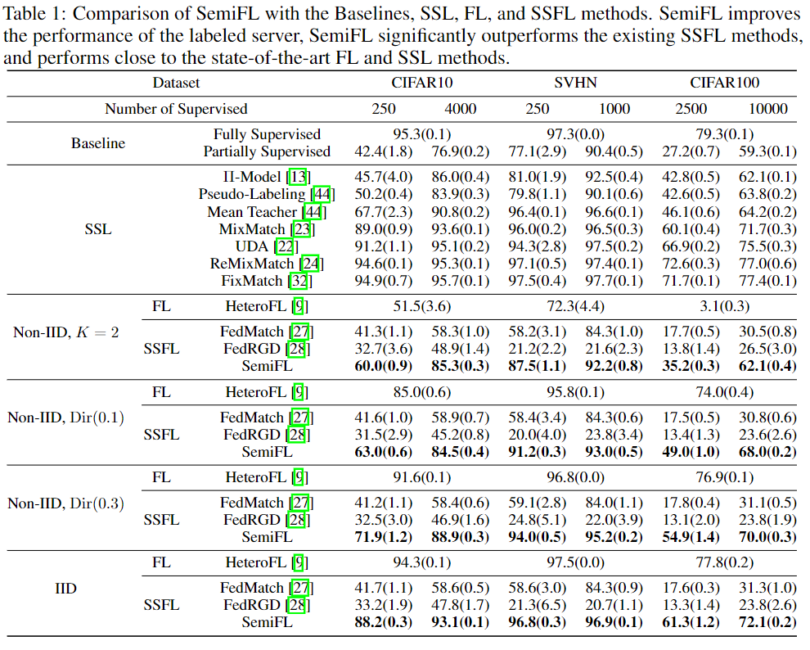
Experiments
Comparison with SSL methods
SemiFL can substantially improve the performance of a labeled server with unlabeled clients in a communication-efficient scenario
Notes:
We demonstrate the results of Fully Supervised and Partially Supervised cases and existing SSL methods for comparison in Table 1. The results show that SemiFL can substantially improve the performance of a labeled server with unlabeled clients in a communication-efficient scenario. Our method performs competitively with the state-of-the-art SSL methods for IID data partition.

Slide 8
Experiments
Comparison with FL and SSFL methods
SemiFL can significantly outperforms SSFL methods and perform competitively with FL results trained with fully supervised data
Notes:
We compare our results with the state-of-the-art FL and SSFL methods in Table 2. Compared with baselines, \textit{the proposed SemiFL is the first SSFL method that actually improves the performance of the labeled server and performs close to the state-of-the-art FL and SSL methods.

Slide 9
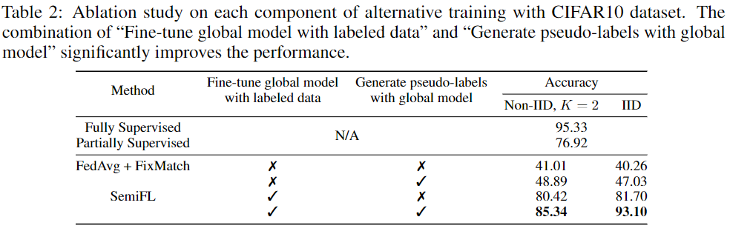
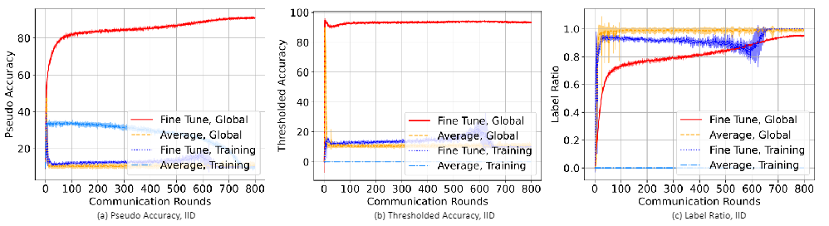
Experiments
Ablation studies
‘Fine-tune global model with labeled data’ and ‘Generate pseudo-labels with global model’ are the critical components of the proposed ‘Alternate Training’ method for the success of our method
Notes:
We conduct ablation studies on SemiFL and demonstrate the results in Table 2. Based on our extensive experiments, it is evident that ``Fine-tune global model with labeled data'' and ``Generate pseudo-labels with global model'' are the critical components of the success of our method. The results of measuring the quality of pseudo-labels also demonstrate that our proposed alternative training can produce pseudo labels of much better quality when clients have completely unlabeled data and train multiple local epochs.

Slide 10
Conclusion
We propose SemiFL in which clients have completely unlabeled data and can train multiple local epochs to reduce communication costs, while the server has a small amount of labeled data.
We develop a theoretical analysis on strong data augmentation for SSL methods, the first in the literature to our best knowledge.
We propose the first communication efficient SSFL method alternate training that can improve the performance of a labeled server by allowing unlabeled clients to train multiple local epochs
Future works can study theoretical understanding of alternate training and applications of semi-supervised federated learning
Notes:
• We propose SemiFL in which clients have completely unlabeled data and can train multiple local epochs to reduce communication costs, while the server has a small amount of labeled data.
• We develop a theoretical analysis on strong data augmentation for SSL methods.
• To the best of our knowledge, we propose the first communication efficient SSFL method alternate training that can improve the performance of a labeled server by allowing unlabeled clients to train multiple local epochs,
• Future works can study theoretical understanding of alternate training and more possible applications of SemiFL

Slide 11
Thank you!

